Slide 1
COMP SCI 1103/2103 Algorithm Design & Data Structure
Recursion 2
School of Computer Science

Slide 2
Review
Recursion
If a problem can be solved recursively, we can always do that iteratively as well.
Sometimes, from a design or conceptual view, recursion is superior.
There will always be efficiency issues in using recursion.

Slide 3
Overview
In this lecture we will discuss:
  More details of recursion.
  Think recursively
  How to improve the efficiency of recursion
    Tail recursion
    Helper function
    Memorization

Slide 4
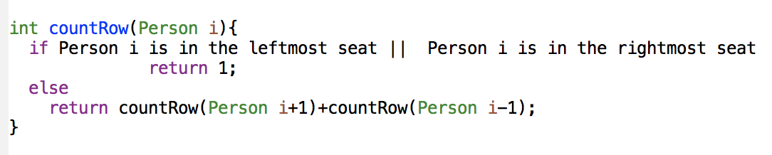
Checklist for Recursion
Three properties to be checked for a recursive algorithm:
  There is no infinite recursion
  Each stopping case performs the correct action
  For all recursive cases: IF all recursive calls perform correctly, THEN the entire case performs correctly.
To use recursion, break the problem into subproblems.
  at least one sub-problem needs to be the same problem as the main problem, but with a smaller size (simpler).
Why does this not work?
Notes:
Infinite recursion can occur if recursion does not reduce the problem in a manner that allows it to eventually converge into the base case.
If a subproblem resembles the original problem, we can apply the same approach to solve the subproblem recursively.

Slide 5
Checking n!
Infinite recursion?
  The relationship n! = n * ( (n-1)! ) has n getting smaller and heading towards 0. Provided we have a base case for 0, no infinite recursion.
Is the returned value for base correct?
  Base case: n = 0, we return 1. This is correct.
Is the relationship for recursion correct?
  If (n-1)! returns the correct result, then n! = n * (n-1)! will return the correct result.
Therefore, this is correct! (But what if n < 0?)
Notes:
5min

Slide 6
Think Recursively
Many of the problems we talked before can be solved using recursion if we think recursively.
Consider the palindrome problem.
A phrase is a Palindrome if it is the same if reversed
glenelg reversed is glenelg
racecar reversed is racecar
How could we determine recursively if a word is a palindrome?
Notes:
To solve a problem recursively requires a different mindset than to solve it by programming loops
A phrase is called a Palindrome if it is the same once reversed.
What about we divide the problem into two subproblems:
Check whether the first char and the last char are the same or not
Ignore these two chars and check the rest of the string is a palindrome or not.
20min

Slide 7
Problem Solving with Recursion
Practice makes perfect!
Step 1. Consider various ways to simplify inputs
  Find sub-problems that perform the same task as the original problem, but with a simpler (or smaller) input.
Step 2. Combine solutions with simpler inputs into a solution of the original problem.
Step 3. Find solutions to the simplest cases.
Step 4. Implement the solution by combining the simple cases and the reduction step.
Notes:
What about we divide the problem into two subproblems:
Check whether the first char and the last char are the same or not
Ignore these two chars and check the rest of the string is a palindrome or not.
20min

Slide 8
Example
bool isPalindrome(string s){
//base
if(s.length()<=1)
return true;
//recursion
if(tolower(s[0]) != tolower(s[s.length()-1]))
return false;
return isPalindrome(s.substr(1,s.length()-2));
}

Slide 9

Recursive Helper Functions
This implementation of isPalindrome() is not efficient. Why?
  It creates a new string for every recursive call
  What about checking whether a substring is a palindrome or not?
It is a common design technique in recursive programming to declare a second function that receives additional parameters.
Notes:
25min

Slide 10
Example
bool isPalindrome(string s){
isPalindromHelper(s, 0, s.length-1);
}
bool isPalindromeHelper(string s, int start, int end){
//base
if(end==-1 || start=end)
return true;
//recursion
if(tolower(s[start]) != tolower(s[end]))
return false;
return isPalindromeHelper(s,start+1, end-1);
}
No string created here. Reusing s. In previous solution, use of substr() created and returned another string.

Slide 11
Stack use for recursive isPalindrome
How does it work?

Slide 12
Heads and Tails
Some compilers perform optimisation to reduce your call overhead.
If possible, the compiler will remove stack heavy operations and replace them with lighter ones.
It’s possible to do this, in recursion, using a technique called ‘tail recursion’.
A recursive function is tail recursive when recursive call is the last thing executed by the function.
Notes:
The recursive function returns the result of a recursive call

Slide 13
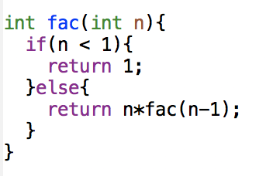
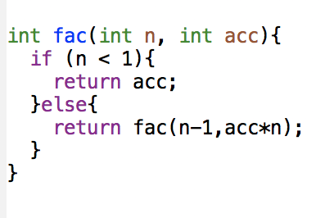
Tail-recursive factorial
How is stack used for this one?
Here’s a recursive factorial that a compiler can optimise to reduce stack overhead:
Notes:
Since there is no additional instructions to execute, there is no need to store the instruction pointer on the stack
30min-35min

Slide 14
More than one call
Recursive functions can generate more than one call on each pass.
Consider the Truckloads problem,
  numTrucks(pile1, loadSize)+numTrucks(pile2, loadSize)
Each call potentially generates two more calls
Explosion!!
  Exponential growth!
You can see how this can quickly add up in terms of space
Notes:
We just express this in one statement #crates < loadSize

Slide 15
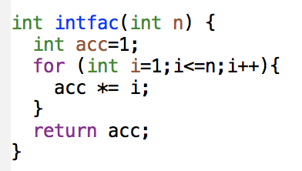
Iterative alternatives
Factorial

Slide 16
Hanoi Tower
The Towers of Hanoi problem can be solved easily using recursion, but is difficult to solve without using recursion.
The problem involves moving a specified number of disks of distinct sizes from one tower to another while observing the following rules:
  Only one more tower can be used other these two towers
  No disk can be on top of a smaller disk at any time
  All the disks are initially placed on one tower
  Only one disk can be moved at a time and it must be the top disk on the tower.

Slide 17
Summary
Recursion is a useful tool for understanding problems and producing solutions, but:
  You can always solve it iteratively
  It can be inefficient and space hungry
  Analysing recursive code can get tricky quickly

Slide 18
Notes:
Save as a PowerPoint Show and upload to your MyUni course.
Before you upload the PPS customise slides and indicate where students will find them.

